Slide 1
以弗所四
11 “祂所赐的有些是使徒……”
12 “成全圣徒，为着职事的工作，为着建造基督的身体”
13 “直到我们众人都达到了…长成的人，达到了基督丰满之身材的度量”
15 “惟在爱里持守着真实，我们就得以在一切事上长到祂，就是元首基督里面”
16 “本于祂，全身借着每一丰富供应的节，并借着每一部分依其度量而有的功用，得以联络在一起，并结合在一起，便叫身体渐渐长大，以致在爱里把自己建造起来”

Slide 2
“One day we will all pass away, and another generation will rise up. The next generation that we bring in must not be made up of three or five serving ones, but must be made up of the whole church serving. If one day the whole church rises up to do everything by itself, with the whole church preaching the gospel and the whole church edifying each other, that will be the day when the world will see the church doing a new thing on earth. Today the whole problem lies with you and me. We must help every brother and sister to serve and make everyone a priest of God. Some may have the flesh with them, but we still have to ask them to work. Some brothers say that what they have is so little that it would be better if they hid it. But we have to tell them that they cannot do this. It is an easy thing for the one-talented ones to hide what they have. Many brothers and sisters feel that since they make mistakes no matter how they work, they may as well not work at all. But we have to ask them to work. This is the way. Please believe my words. In the not-too-distant future such a church will appear. By that time men will see Philadelphia, the genuine brotherly love.”—CWWN Vol 57, ch 6

Slide 3
Vital Group for realizing the perfecting of the saints in Eph 4
THE PURPOSE—FOR THE INCREASE, THE PERFECTING, AND THE BUILDING UP OF THE CHURCH
“The purpose of the vital groups is the increase, perfecting, and building up of the Body of Christ (Acts 2:46-47; Eph. 4:12). The vital groups are to gain the increase, finish the perfecting, and complete the building.
Ephesians 4:12 speaks of the perfecting of the saints that each one may do the unique work of the ministry, that is, to build up the Body of Christ. This is the purpose of the vital move to have the groups.”—Fellowship concerning Urgent Need of VG

Slide 4
基督
恩赐 恩赐 恩赐
圣徒们 圣徒们 圣徒们

Slide 5
基督
赐 赐 赐
恩赐 恩赐 恩赐
圣徒们 圣徒们 圣徒们

Slide 6
基督
给 给 给
恩赐-----------恩赐--------------恩赐
成全 成全 成全
圣徒们------------圣徒们------------圣徒们

Slide 7
基督
赐 赐 赐
恩赐----联络--恩赐---联络--恩赐
成全 成全 成全
圣徒们—结合----圣徒们---结合----圣徒们

Slide 8
基督
赐 赐 赐
恩赐----联络—恩赐---联络—恩赐
成全 成全 成全
恩赐----联络—恩赐---联络—恩赐
成全 成全 成全
圣徒们—结合----圣徒们---结合----圣徒们

Slide 9
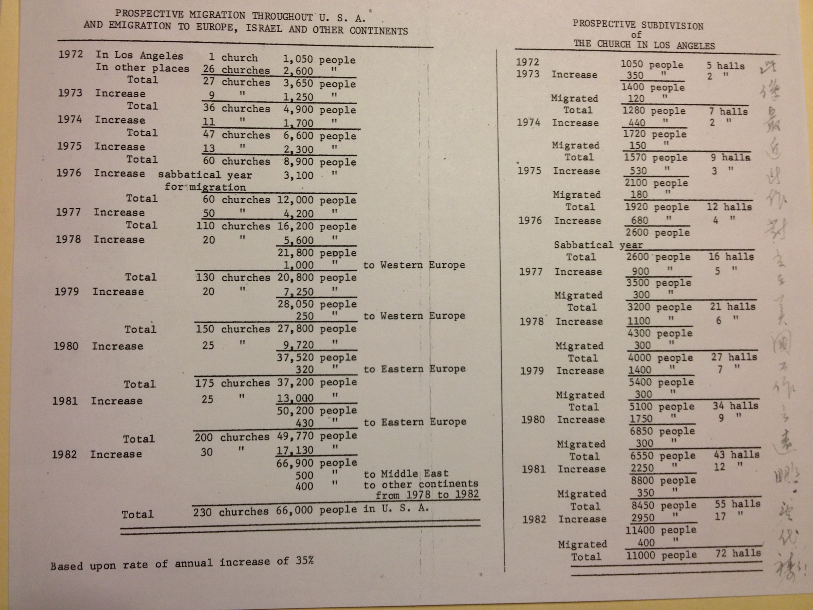

Slide 10
人类细胞和细菌生长速度对比
人类细胞: Granulocytes:eosinophils basophils, neutrophils:10 hours to 3 days; Stomach lining cells: 2 days; Sperm cells:2-3 days; Colon cells:3-4 days; Epithelia of small intestine:1 week or less; Platelets:10 days; Skin epidermal cells:2 - 4 weeks; Lymphocytes:2 months - a year (highly variable); Red blood cells:4 months; Stomach lining cells:2 days; Macrophages:months – years; Endothelial cells:months – years; Pancreas cells:1 year or more; Bone Cells:25 - 30 years
细菌: every 20 minutes; 10⁷ to 10⁸ bacteria in about 12 hours.

Slide 11
这些弟兄们是指谁说的?
你!

Slide 12
“要你們的果子常存”
“That your fruit should remain”
约翰福音 十五16

Slide 13
Apple Trees | 2-5 years 蘋果
Apricot Trees | 2-5 years 杏树
Banana Plants | 2-3 years 香蕉
Cherry Trees (sour) | 3-5 years 酸樱桃
Cherry Trees (sweet) | 4-7 years 甜樱桃
Citrus Trees | 1-2 years 柑橘
Fig Trees | 1-2 years 无花果
Mulberry Trees | 2-3 years 桑树
Nectarine Trees | 2-4 years 油桃
Olive Trees | 2-3 years 橄榄
Pawpaw Trees | 5-7 years 木瓜
Peach Trees | 2-4 years 桃树
Pear Trees | 4-6 years 梨树
Persimmon Trees | 3-4 years 杮子
Plum Trees | 3-6 years 李子

Slide 14
第一年 First Year

Slide 15
第二年 Second Year

Slide 16
第三年 Third Year

Slide 17
第四年 Fourth Year

Slide 18
第五年 Fifth Year

Slide 19
1 人 13人
+ 12 人

